Slide 1

DATA SCIENCE USING PYTHON
MCA-5655
R.MADHUMITHA
(22MCA17)

Slide 2
Data Science Lifecycle
Defining and understanding the problem
Data collection
Data preprocessing
Exploratory data analysis
Data Visualization

Slide 3
Project- Student Data Analysis in Data Science
PROBLEM :
Develop or design a project in data science for UG mark, two semesters marks and attendance.
Language used : Python
Software used in the project : Spyder
Purpose of this project : Analysing the attendance based on the marks of each subject.

Slide 4
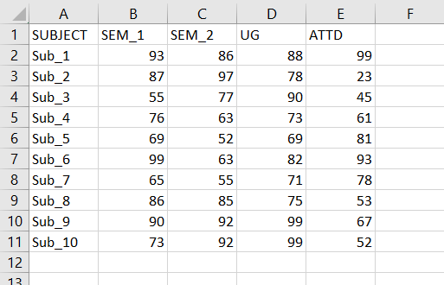
Defining and Understanding the Data
Here we are defining marks for 10 subjects in each attribute and we are entering the data in an excel sheet by saving it in .csv extension.
After that here importing the .csv file in out Python code.

Slide 5
Data Collection
Here, we are collecting the required data from the dataset.
The data that are collected may be the number of records and datatype entered in the dataset.
We are mining the data from the dataset by extracting the specific record.
Here, we are extracting the data of the SEM_1 and SEM_2 from the dataset. We can also extract the data of the other attributes too.
We use pandas for importing the .csv file.

Slide 6
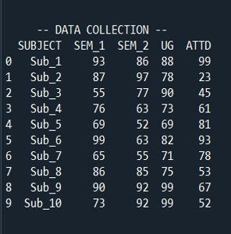
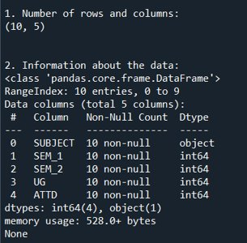
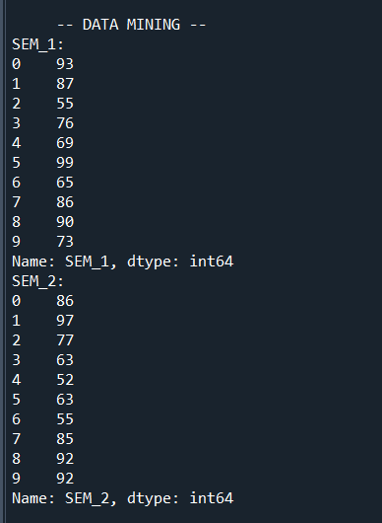

Slide 7
Data Preprocessing
The preprocessing of the dataset can be done by predicting the values from it and cleaning the incorrect, missing values or inconsistent values from the dataset.
describe() is used for predicting the values in the dataset. The predicts the values given in the dataset and it gives an accurate result.
isnull() is used for cleaning the values of the dataset. This function checks for an irrelevant or missing value in the dataset and it prints true if there exists otherwise it prints false.

Slide 8
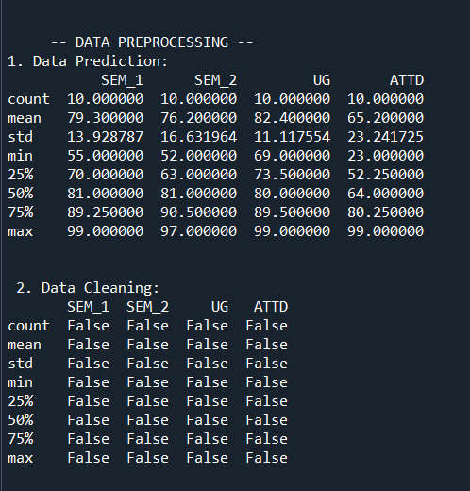
In the data prediction it shows the total count of records, mean, minimum value, maximum value of the given dataset.
In data cleaning, the imported dataset has no missing or inconsistent values in the dataset. Thus it prints false in the output.

Slide 9
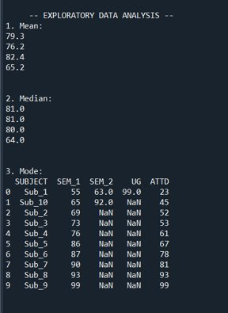
Exploratory Data Analysis
In this, we are analysing the values from the dataset by finding its mean, median and mode.
The mean may be average of the values in the dataset, median is the middle value and mode is the most occurred value.
Here we are analysing the mean, median mode values of the data set to analyse the attendance based on the marks of each subject.

Slide 10
Data Visualization
It is the last step of the data science in which we visualize the data that are processed so far.
It is a technique of presenting the data graphically or in a pictorial format which helps to understand large qualities of data very easily.
This allows the decision makers to make better decisions and also identifying new trends, patterns in a more efficient way.
Here, we visualize the data from the dataset using different types of charts.

Slide 11
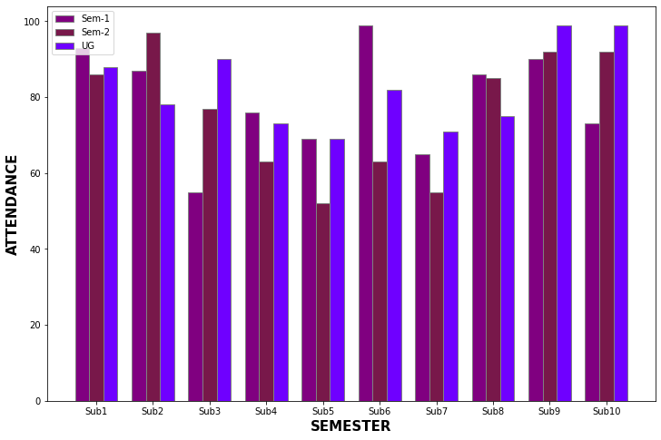
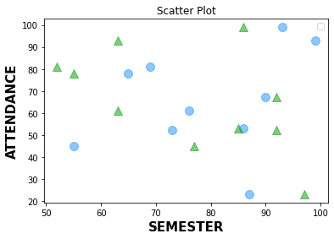
Here, we analyse the attendance of various attributes of the dataset using bar chart and scatter plot.
In the scatter plot, we visualize the marks of each subject in semester 1 and semester 2 with the attendance.
In the bar chart, we visualize the attendance of each subject with each marks as well.

Slide 12
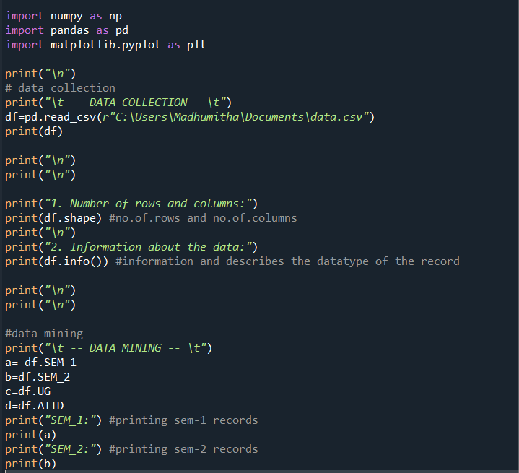
Sample Code and Screenshots

Slide 13
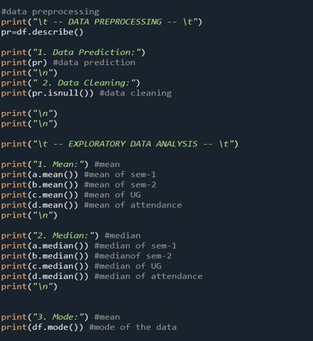

Slide 14
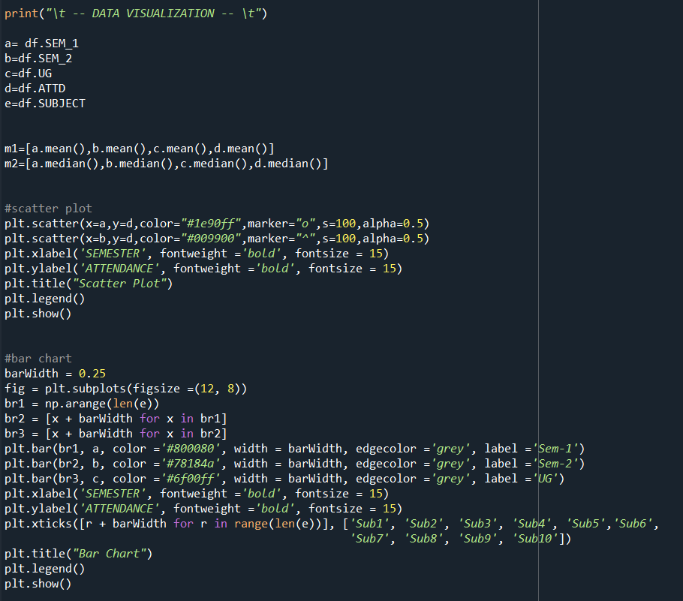

Slide 15
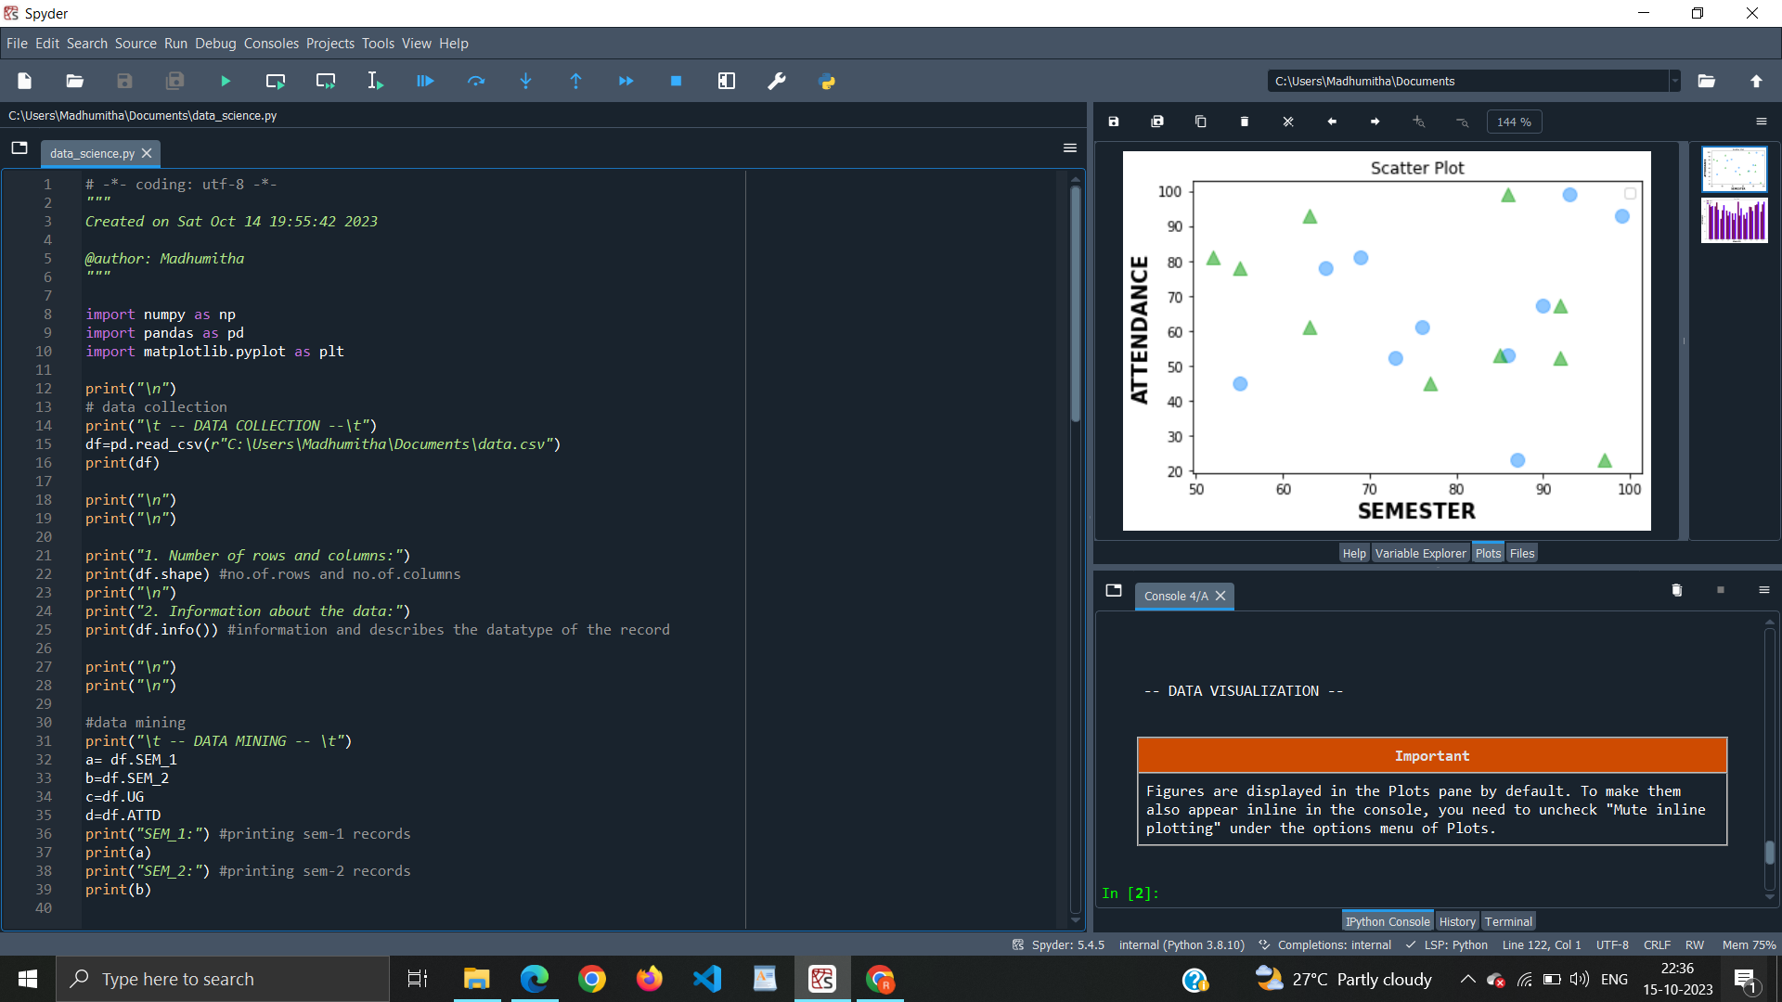

Slide 16
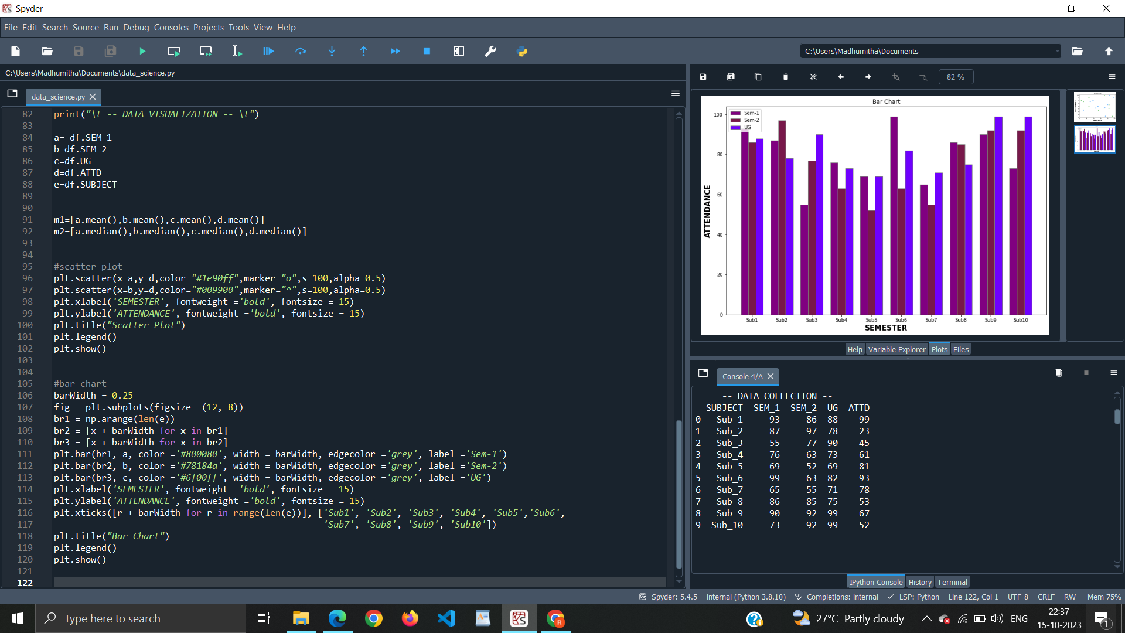

Slide 17
THANK YOU

